Slide 1
AWS DevOps Professional
Course Introduction | Theory
AWS Regions and Availabilty Zones | Theory
Major Services | Theory
VPC | Theory/Lab
Trusted Advisior | Theory/Lab
AWS Cloud Trail | Theory/Lab
IAM | Theory/Lab
S3 | Theory/Lab
AWS Cloud Front | Theory/Lab
AWS Cloud Watch | Theory/Lab
AWS EC2 | Theory/Lab
Elastic Load Balancer & AutoScaling | Theory/Lab
AWS Route 53 | Theory/Lab
AWS Simple Queue Service | Theory/Lab
AWS Simple Notification Service | Theory/Lab
AWS lambda | Theory/Lab
AWS RDS | Theory/Lab
AWS CloudFormation | Theory/Lab
AWS CodeDeploy | Theory/Lab
AWS Elastic Beanstalk | Theory/Lab
Amazon EC2 Container Registry | Theory/Lab
Other Topics and Assignment
Blue Green Deployment | Theory/ Assignment
Immutable Deployment | Theory/ Assignment
Server less Computing | Theory/ Assignment

Slide 2

Amazon Web Services Exam
CO-CREATION | COLLABORATION | COORDINATION
AWS Cloud Computing White Papers:
Overview Of Amazon Web service
Overview of Security Process
AWS Risk and Compliance Whitepaper
Storage Options in the Cloud
Architecting for the AWS Cloud: Best Practices
Well Architected Framework
Final Exam
www.tpsworldwide.com

Slide 3
Amazon Web Services
CO-CREATION | COLLABORATION | COORDINATION
AWS offers a broad set of global cloud-based products including compute, storage, database, analytics, networking, machine learning and AI, mobile, developer tools, IoT, security, enterprise applications, and much more
/company/tpsworldwide
/tpsworldwide
/tpsworldwide
www.tpsworldwide.com

Slide 4

AWS User Accounts
CO-CREATION | COLLABORATION | COORDINATION
There are two types of users:
Root User
Account owner
Created when the AWS account is created
Allow full access to all resources in the account
Only the root user can close your account
AWS Identity and Access Management (IAM) user
Created by the root user or an IAM administrator for the account
Securely control access to AWS services and resources
/company/tpsworldwide
/tpsworldwide
/tpsworldwide
www.tpsworldwide.com

Slide 5
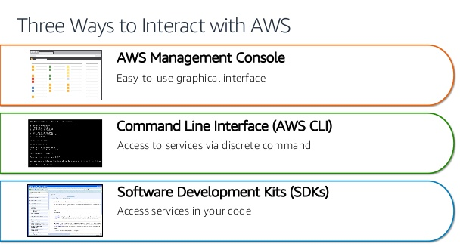
AWS Connectivity
CO-CREATION | COLLABORATION | COORDINATION
/company/tpsworldwide
/tpsworldwide
/tpsworldwide
www.tpsworldwide.com

Slide 6
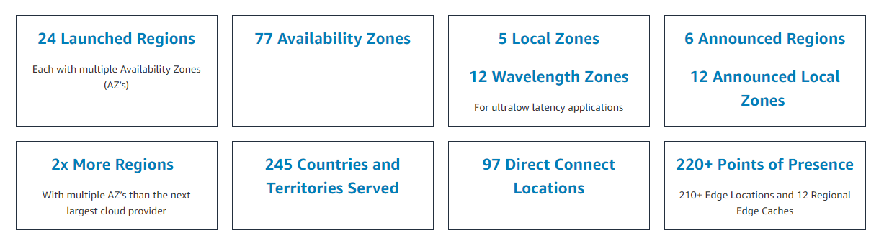
Regions and Zones
Amazon EC2 is hosted in multiple locations world-wide. These locations are composed of Regions, Availability Zones, Local Zones, AWS Outposts, and Wavelength Zones. Each Region is a separate geographic area.
CO-CREATION | COLLABORATION | COORDINATION
www.tpsworldwide.com

Slide 7
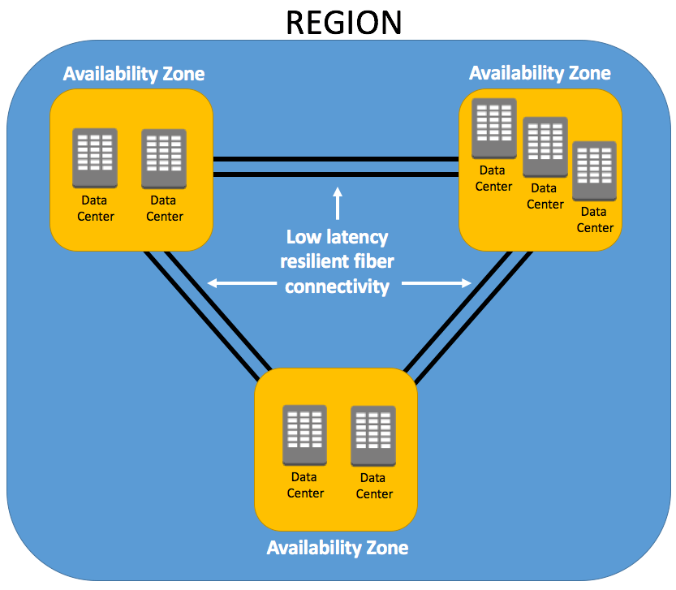
Availability Zones:
Every region consists of two or more cluster of datacenters called “Availability Zones”
Every Availability Zone has a corresponding code which consists of region code followed by alphabets
US West (Oregon) four availability zones:
Region code: us-west-2
Availability zone 1: us-west-2a
Availability zone 1: us-west-2b
Availability zone 1: us-west-2c
Availability zone 1: us-west-2d
https://docs.aws.amazon.com/AWSEC2/latest/UserGuide/using-regions-availability-zones.html

Slide 8
Amazon ECS supports workloads that take advantage of Local Zones, Wavelength Zones and AWS Outposts when low latency or local data processing requirements are needed.
Local Zones are an extension of an AWS Region that provide you the ability to place resources in multiple locations closer to your end users.
Wavelength Zones allow developers to build applications that deliver ultra-low latencies to 5G devices and end users. Wavelength deploys standard AWS compute and storage services to the edge of telecommunication carriers' 5G networks.
AWS Outposts brings native AWS services, infrastructure, and operating models to virtually any data center, co-location space, or on-premises facility.
https://docs.aws.amazon.com/AWSEC2/latest/UserGuide/using-regions-availability-zones.html

Slide 9
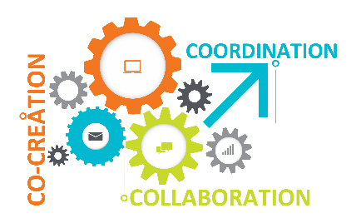
Selecting AWS Region
Proximity to Customers
CO-CREATION | COLLABORATION | COORDINATION
Select the region where most of your end users are located. It ensures the best user experience. For example, if most of your end users are located in South America, in this case, selecting the Sao Paulo region will be better than the Singapore region.
1
1
Compliance
2
You may have data compliance requirements where your data needs to reside in a certain country or replicated to a specific country for disaster recovery.
Service availability
3
While most of the popular AWS services are available in all regions, not all AWS services are available in all regions. In deciding on a region, consider your current and future business needs.
Cost
4
Price across regions varies due to different regulations in each country, capital, and operational expenses such as the cost of electricity
/company/tpsworldwide
/tpsworldwide
/tpsworldwide
www.tpsworldwide.com

Slide 10

CO-CREATION | COLLABORATION | COORDINATION
AWS Services
/company/tpsworldwide
/tpsworldwide
/tpsworldwide
www.tpsworldwide.com

Slide 11
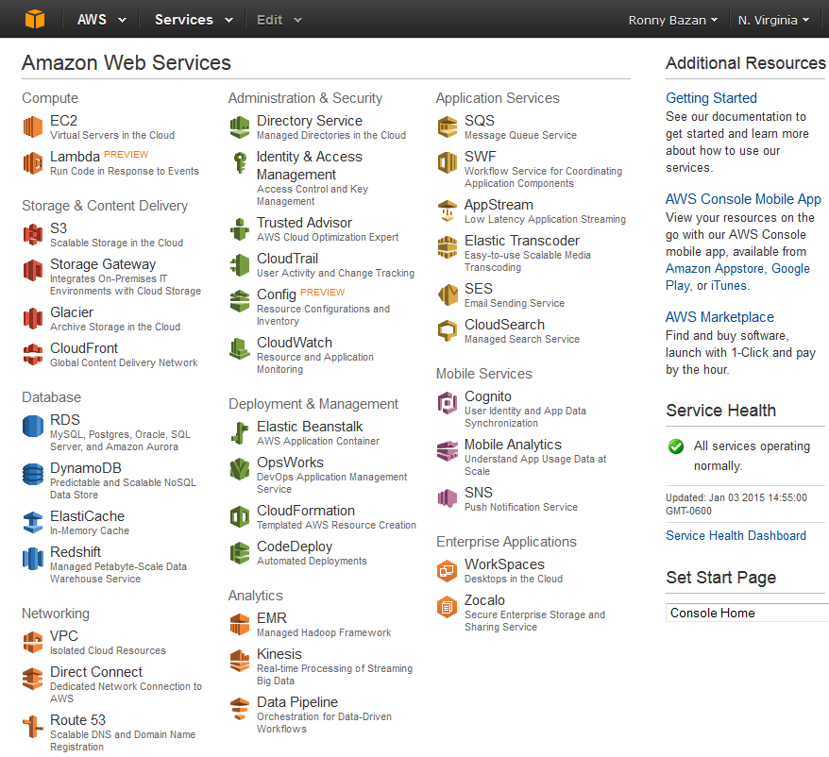

Slide 12
Introduction to Amazon EC2
Amazon EC2:
“Amazon EC2 stand for (Elastic Computing Cloud). AWS EC2 is a backbone of AWS. AWS EC2 offers scalable computing capacity that allows business subscribers to run application and programs in the Cloud environment.”
CO-CREATION | COLLABORATION | COORDINATION
Elastic Web-Scale Computing
Completely Control
Flexible Cloud Hosting Services
Integrated
Reliable
Secure
/company/tpsworldwide
/tpsworldwide
/tpsworldwide
www.tpsworldwide.com

Slide 13
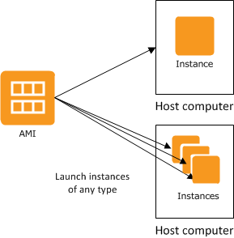
Amazon Machine Image (AMI)
AMIs:
An Amazon Machine Image (AMI) is a template that contains a software configuration (for example, an operating system, an application server, and applications)
AMI is used to launch an instance, which is a copy of the AMI running as a virtual server in the cloud.
Multiple instances of an AMI can be launched, as shown in the following figure.
CO-CREATION | COLLABORATION | COORDINATION
/company/tpsworldwide
/tpsworldwide
/tpsworldwide
www.tpsworldwide.com

Slide 14
Introduction to Amazon ElastiCache
ElastiCache:
Amazon ElastiCache makes it easy to deploy and manage a highly available and scalable in-memory data store in the cloud. Among the open source in-memory engines available to you for use with ElastiCache is Redis, which added powerful geospatial capabilities.
CO-CREATION | COLLABORATION | COORDINATION
/company/tpsworldwide
/tpsworldwide
/tpsworldwide
www.tpsworldwide.com

Slide 15
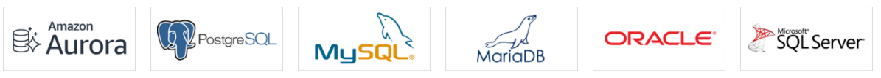
Amazon RDS
A web service that makes it easier to set up, operate, and scale a relational database in the AWS Cloud
Provides cost-efficient, resizable capacity for an industry-standard relational database and manages common database administration tasks.
RDS manages backups, software patching, automatic failure detection, and recovery.
To deliver a managed service experience, Amazon RDS doesn't provide shell access to DB instances.
It also restricts access to certain system procedures and tables that require advanced privileges.
You can have automated backups performed when you need them, or manually create your own backup snapshot.
CO-CREATION | COLLABORATION | COORDINATION
/company/tpsworldwide
/tpsworldwide
/tpsworldwide
www.tpsworldwide.com

Slide 16

Amazon S3
CO-CREATION | COLLABORATION | COORDINATION
Amazon S3 (Simple Storage Service) is object storage built to store and retrieve any amount of data from anywhere on the Internet.
S3 is a scalable, high-speed, web-based cloud storage service.
An object consists of data, key (assigned name), and metadata.
A bucket is used to store objects. When data is added to a bucket, Amazon S3 creates a unique version ID and allocates it to the object.

Slide 17
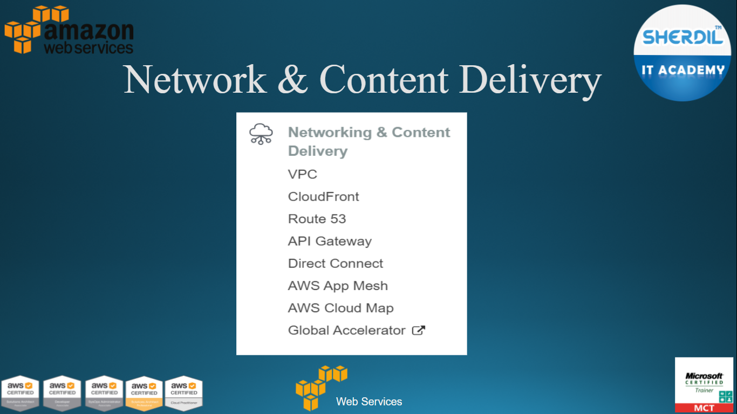


Slide 18
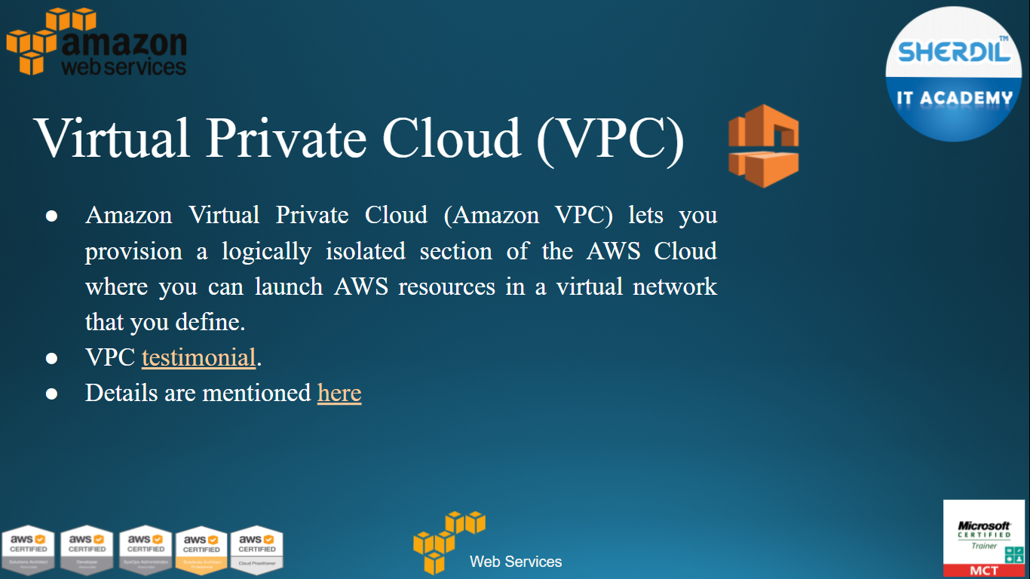

Slide 19
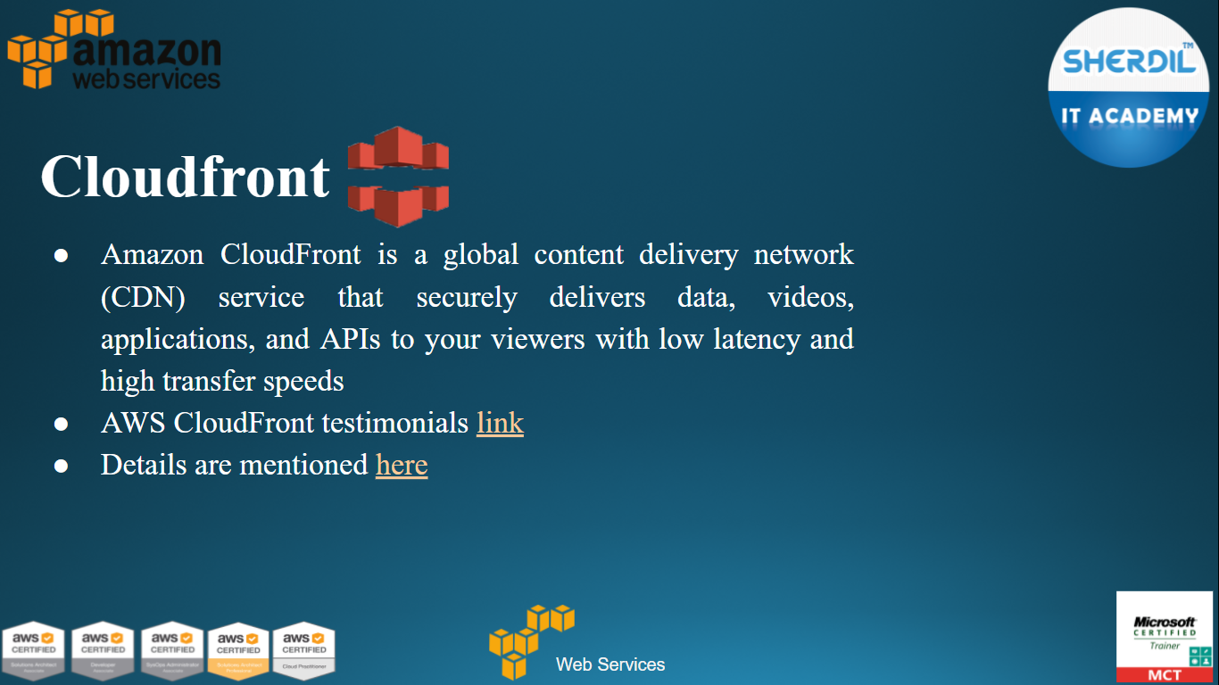

Slide 20
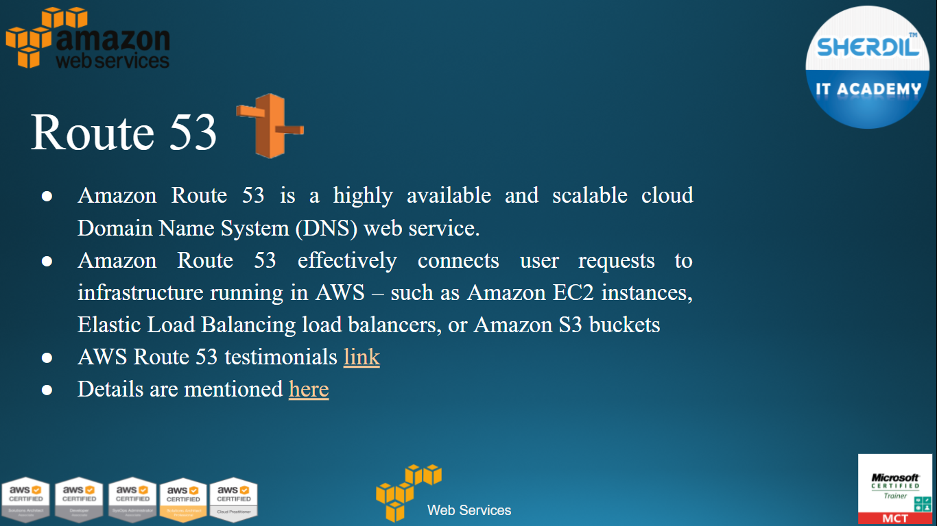

Slide 21
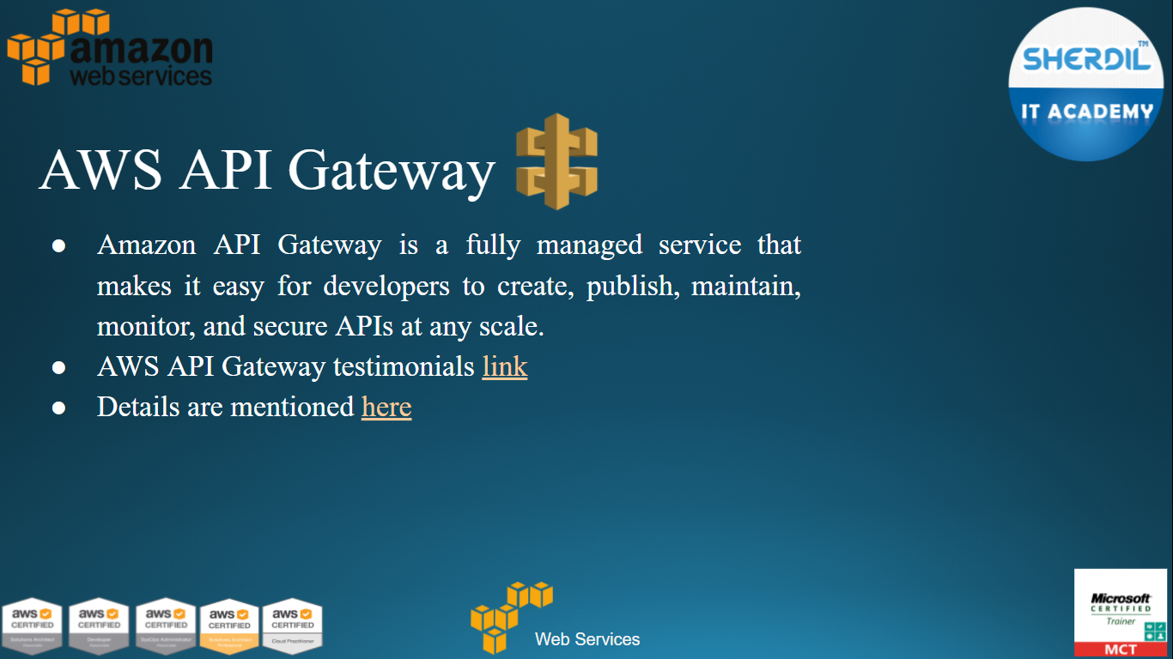

Slide 22
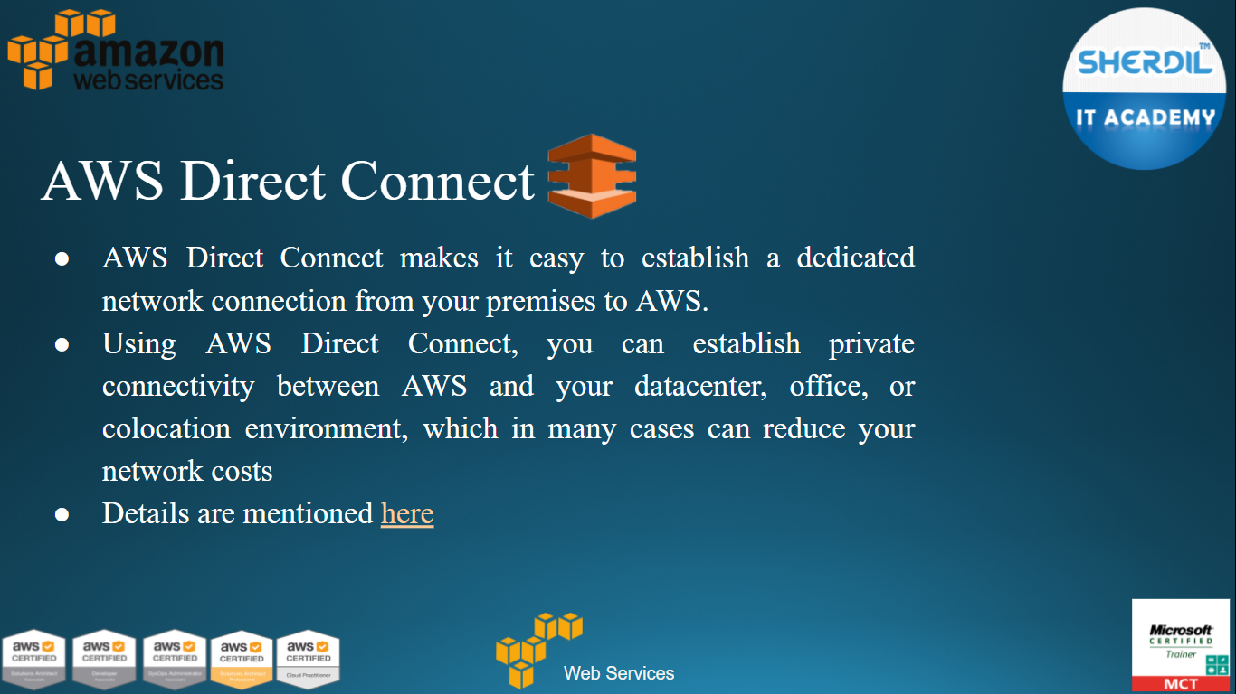

Slide 23
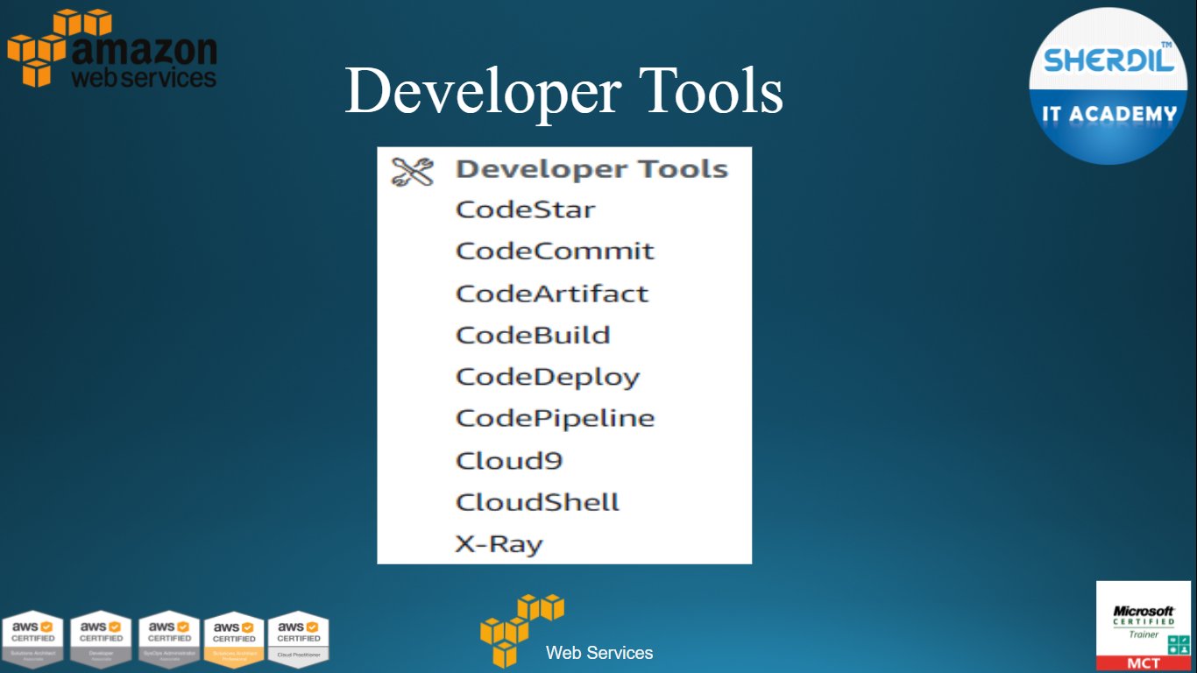

Slide 24
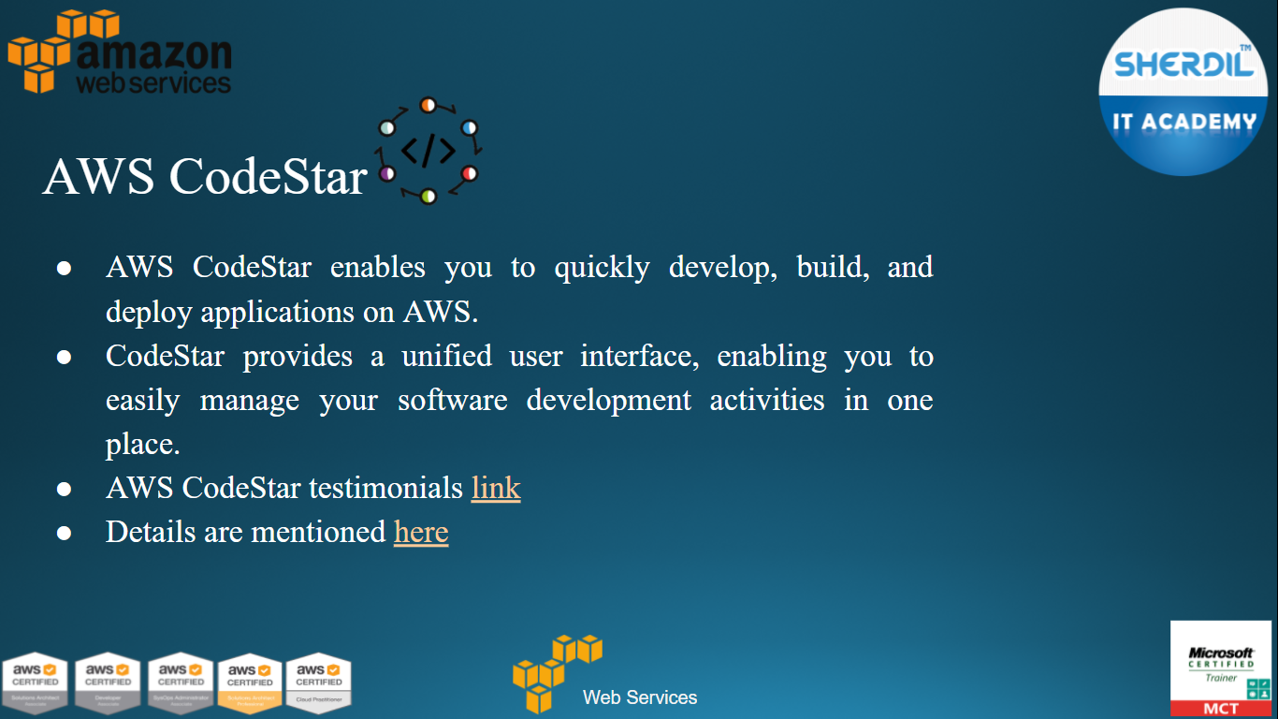


Slide 26
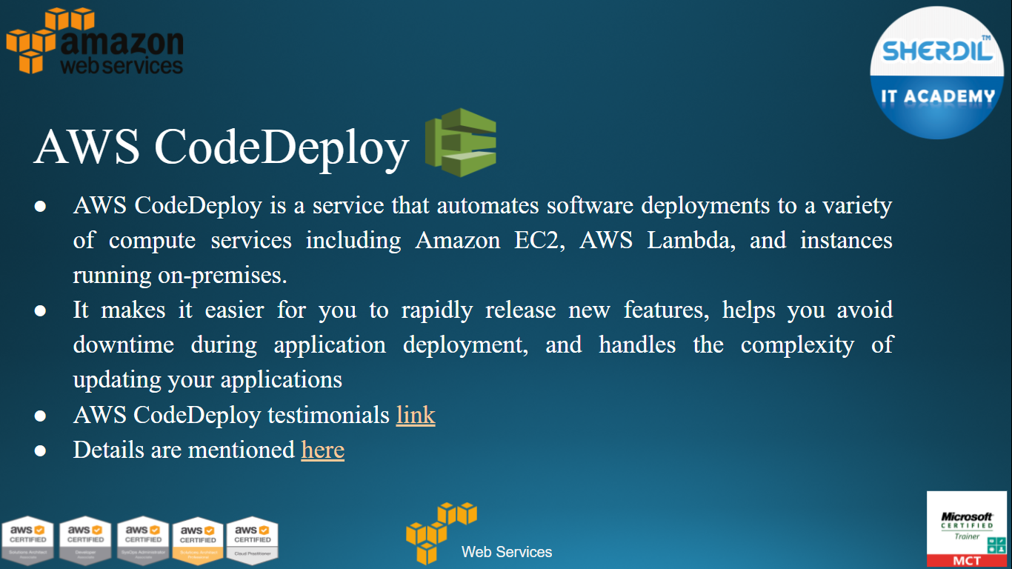

Slide 27
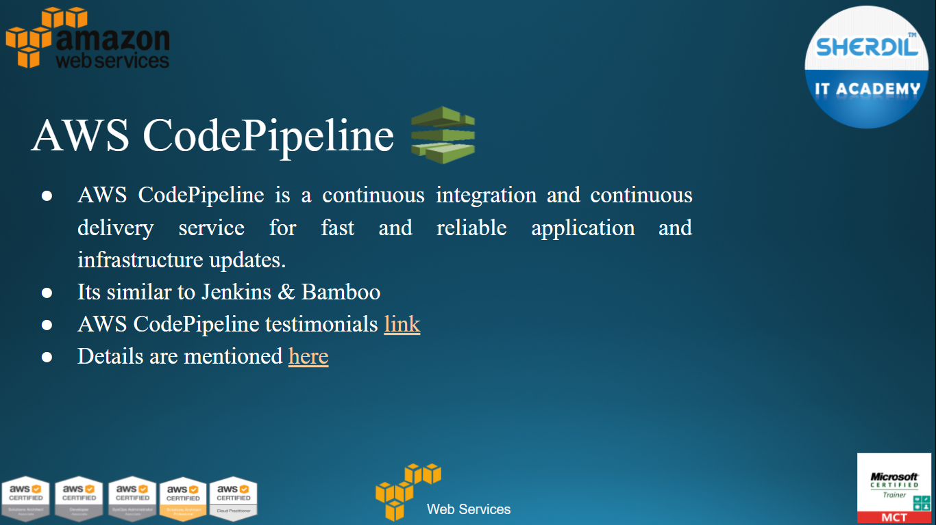

Slide 28
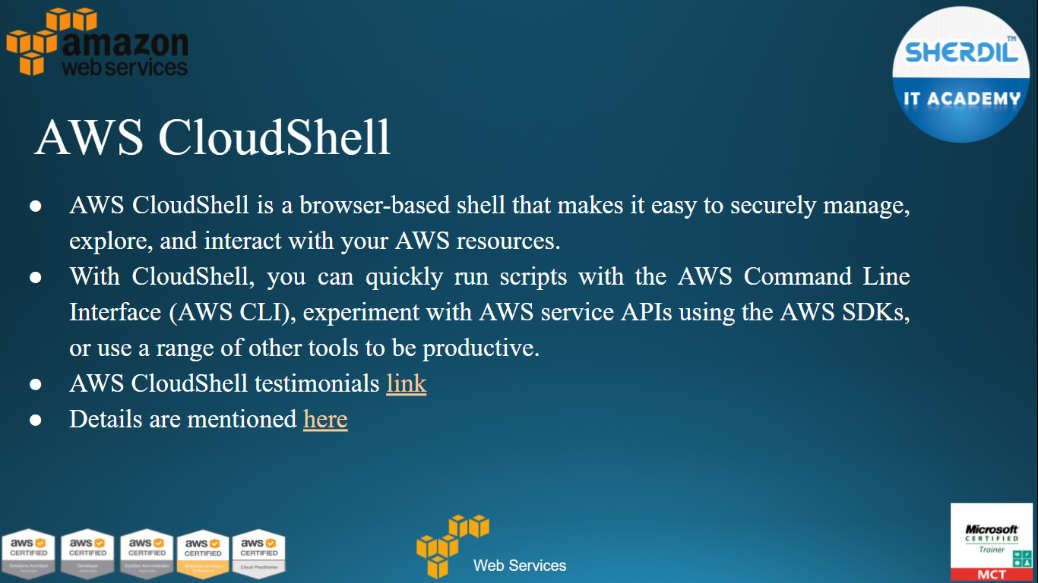

Slide 29
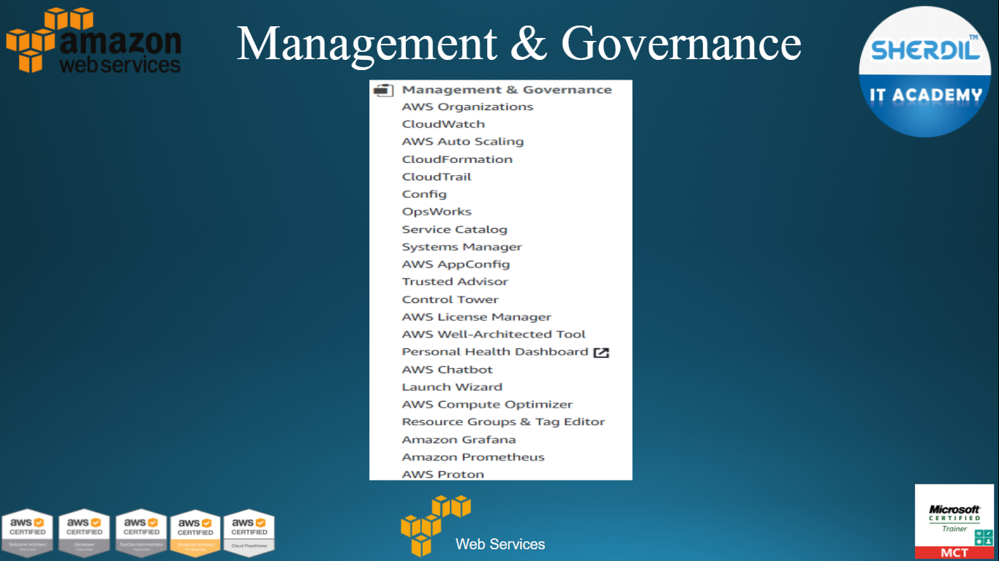

Slide 30
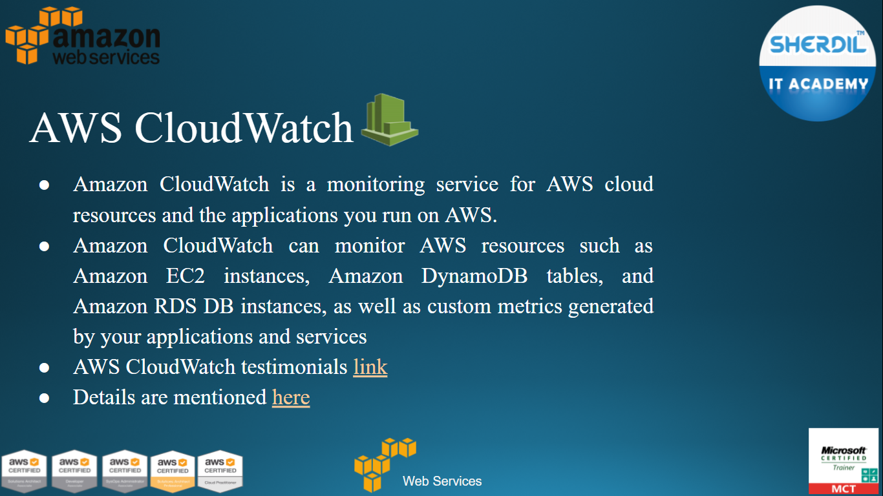

Slide 31
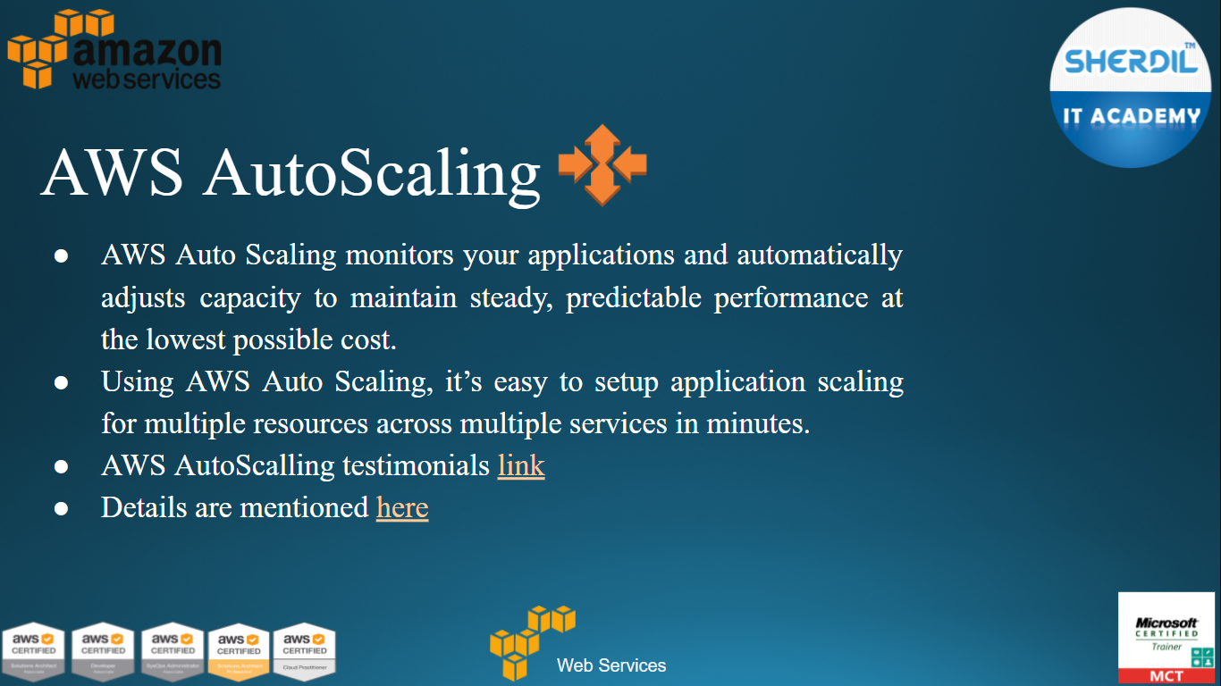

Slide 32
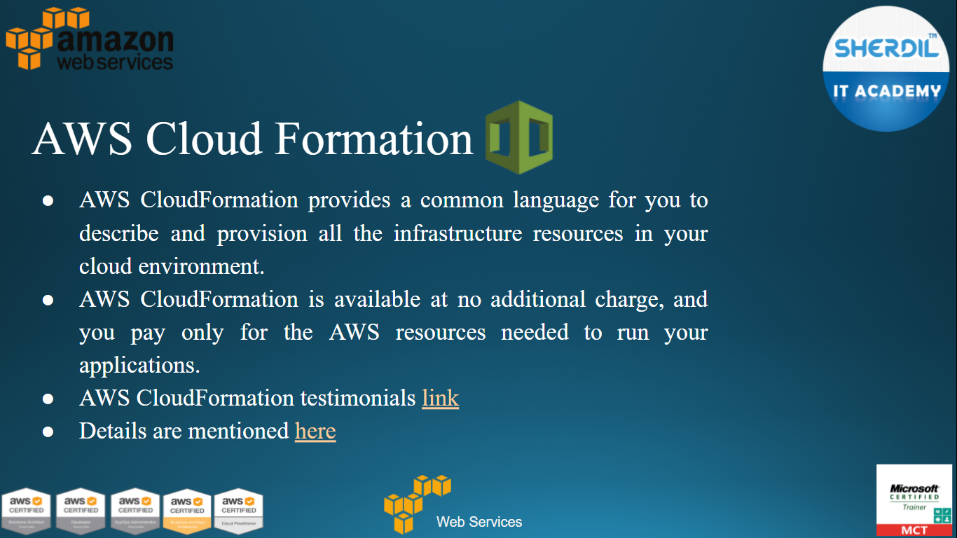

Slide 33
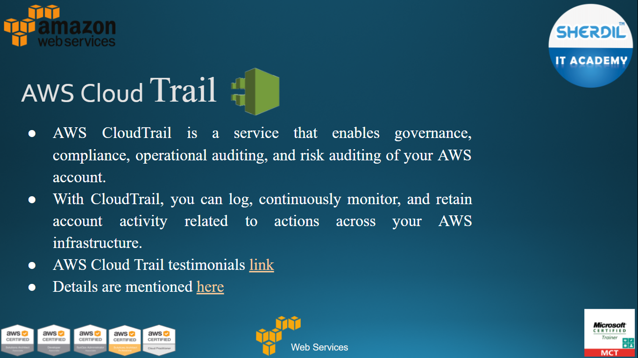

Slide 34
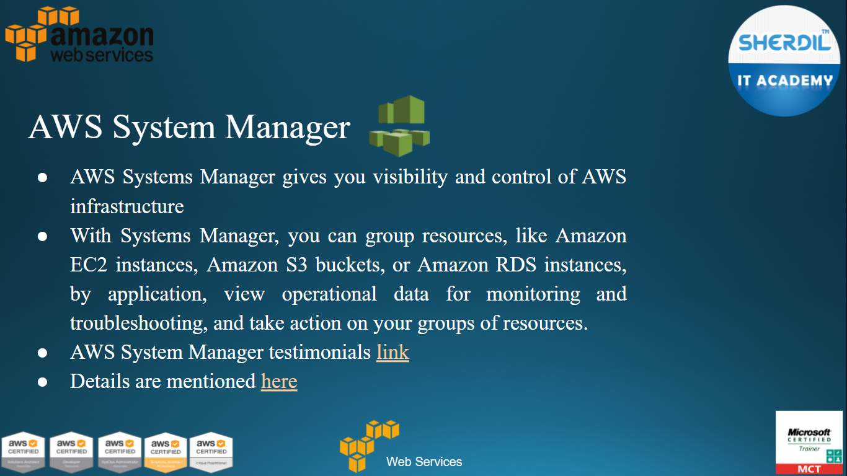

Slide 35
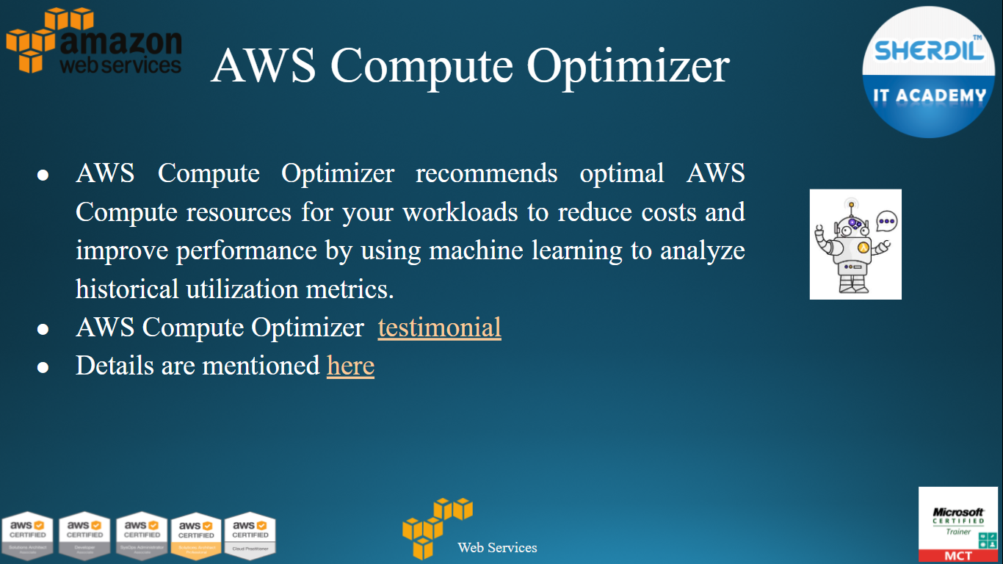

Slide 36
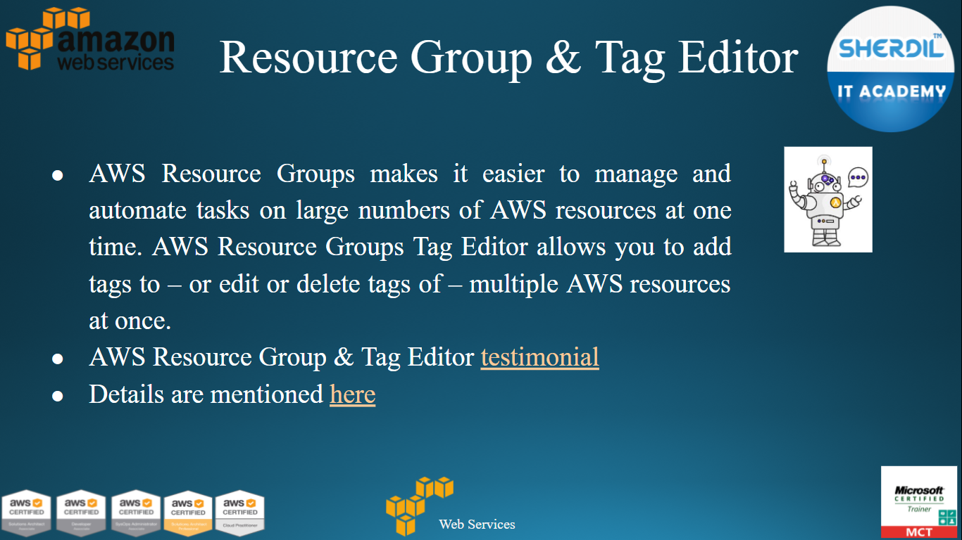

Slide 37
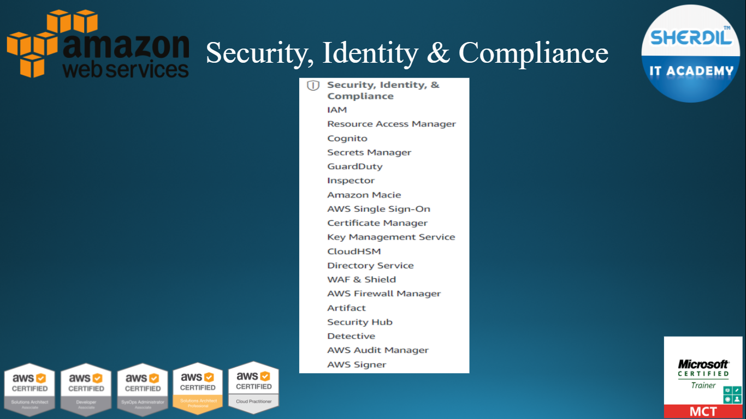

Slide 38
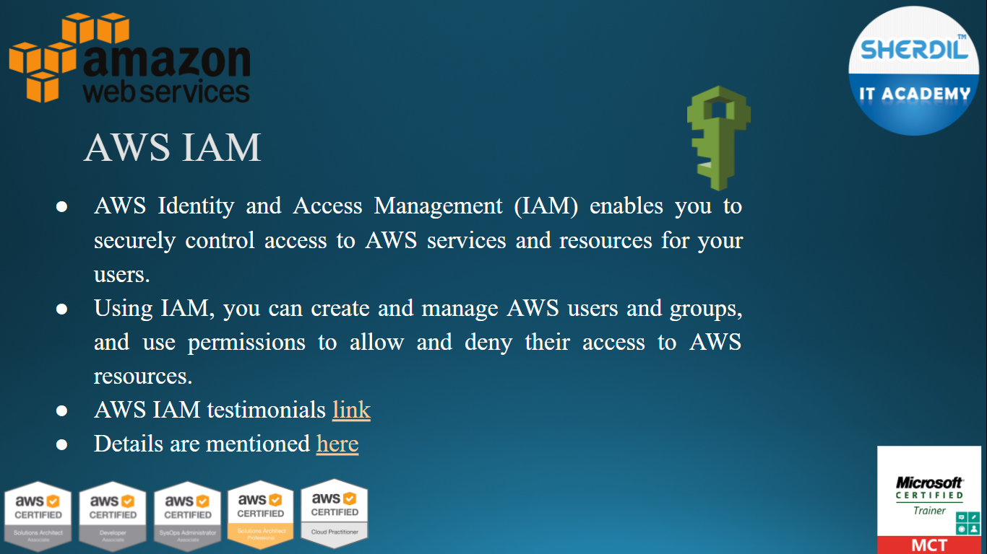

Slide 39
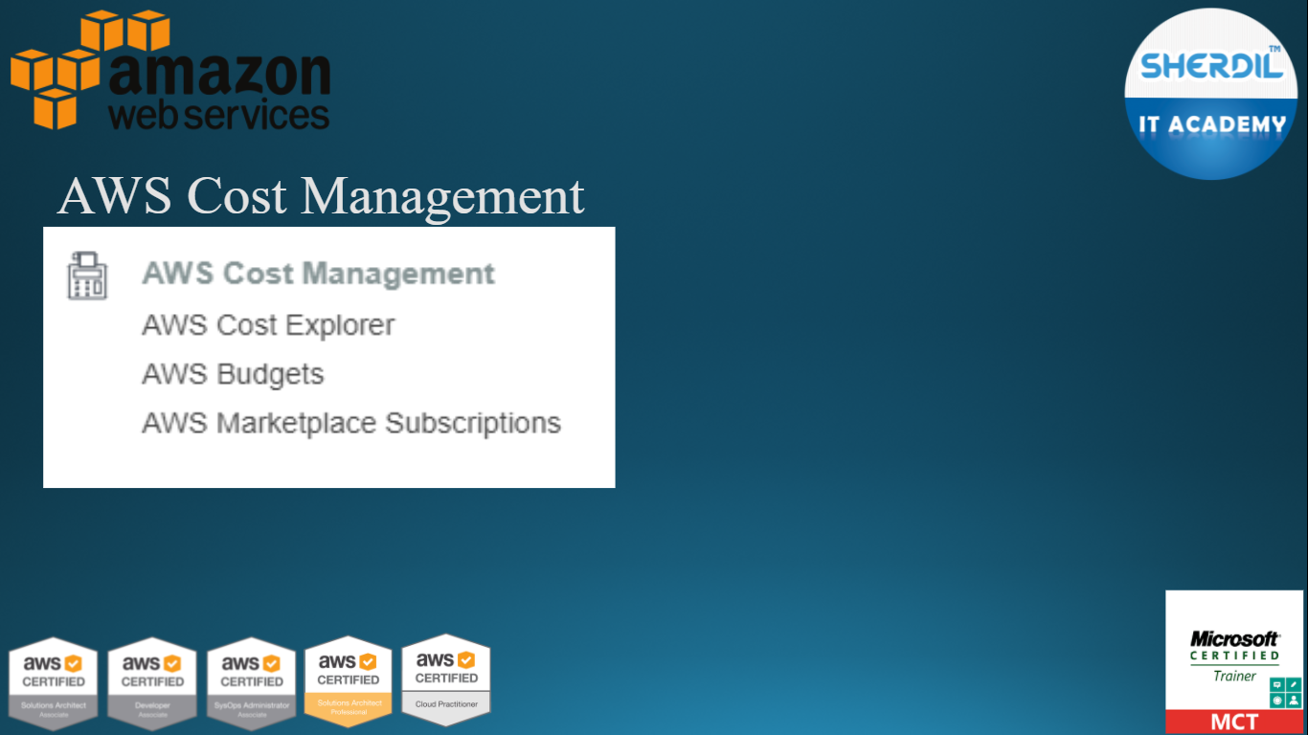

Slide 40
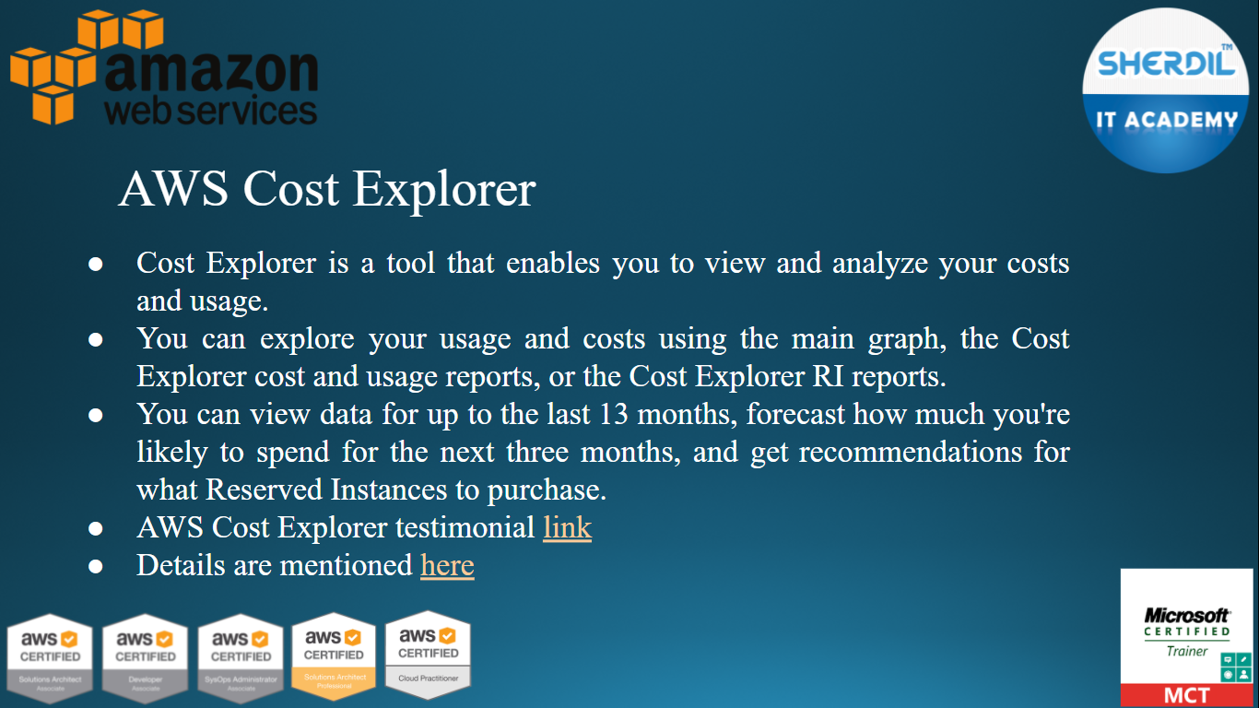

Slide 41
